Slide 1
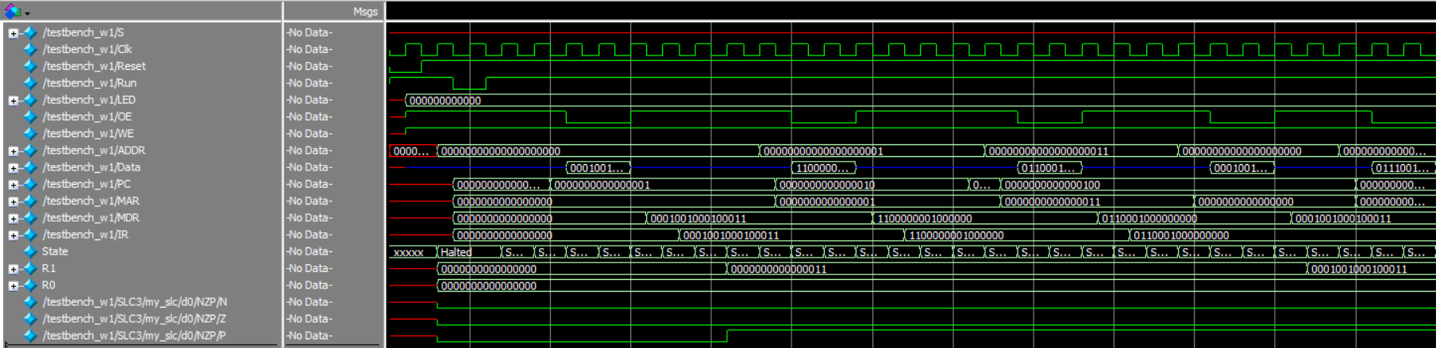
A B C D E F G H
A: IR <- MDR (beginning of instruction ADD R1, R0, #3);
B: R1 <- R0 + 3 and setCC (NZP = 001)
C: IR <- MDR (beginning of instruction JMP R1);
D: PC <- R1 (this can be seen by MAR <- 0x3 instead of 0x2 in the next fetch cycle);
E: IR <- MDR (beginning of instruction LDR R1, R0, #0);
F: MAR <- R0 + 0;
G: MDR <- M[MAR] (this is the add instruction 0x1223 from marker A);
H: R1 <- MDR and setCC (NZP = 001);

